Slide 1
Breast Cancer Prediction
Group - 19
Prepared by:
Mst. Sumiya Siddika (Roll- 192292, Class Roll: 1975)
Md. Shakil Ahmed (Roll- 192330, Class Roll: 2013)
Amit Azim Amit (Roll- 192347, Class Roll: 2090)

Slide 2
Project Supervisor:
Md. Mahmudur Rahman
Lecturer
Institute of Information Technology
Jahangirnagar University

Slide 3
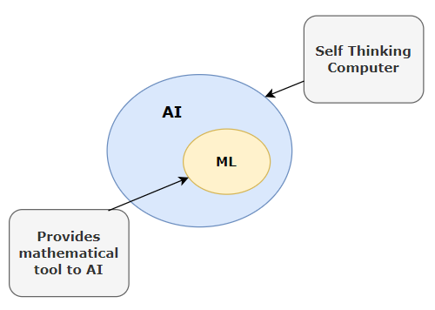
Introduction
Our project, named Breast Cancer Prediction here we developed our project using machine learning. Machine learning (ML) is a field of artificial intelligence that uses statistical techniques to give computer systems the ability to "learn" (e.g., progressively improve performance on a specific task) from data, without being explicitly programmed.

Slide 4
Overview
A detailed description of the proposed machine learning methods used to create predictive model to foretell the detection of breast cancer. In this endeavor, the database included 569 independent data, 35% of which were from breast cancer patients with 31 attributes in which records were obtained from Kaggle.
The Support Vector Machine(SVM), K-Nearest Neighbors(KNN), and Logistic Regression Machine Learning Algorithm were used in this study.

Slide 5
Objective
The main objectives are:
Gather information on a large number of women, such as their reproductive histories, lifestyle variables, and personal and family histories of breast cancer.
Determine which variables have the strongest correlations with the risk of breast cancer by using machine learning methods.
Use a different dataset of women with breast cancer diagnoses to validate the model.

Slide 6
Required Library
Seaborn
Matplotlib
Pandas
NumPy
Scikit Learn

Slide 7
Algorithms
Support Vector Machines(SVM)
K-Nearest Neighbors (KNN)
Logistic Regression

Slide 8
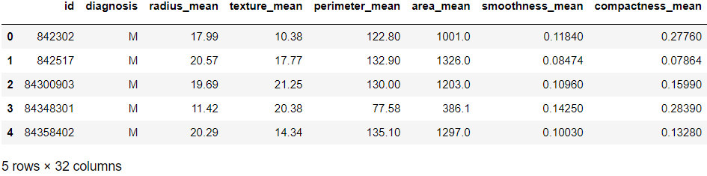
Methodology
1. Identify data sources
The first two columns in the dataset store the unique ID numbers of the samples and the corresponding diagnosis (M=malignant, B=benign), respectively.
The columns 3-32 contain 30 real-value features that have been computed from digitized images of the cell nuclei, which can be used to build a model to predict whether a cancer is benign or malignant.

Slide 9
Methodology
2. Exploratory Data Analysis
There are two approaches used to examine the data.
Descriptive statistics is the process of condensing key characteristics of the data set into simple numeric metrics. Some of the common metrics used are mean, standard deviation, and correlation.
Visualization is the process of projecting the data, or parts of it, into Cartesian space or into abstract images. In the data mining process, data exploration is leveraged in many different steps including preprocessing, modeling, and interpretation of results.

Slide 10
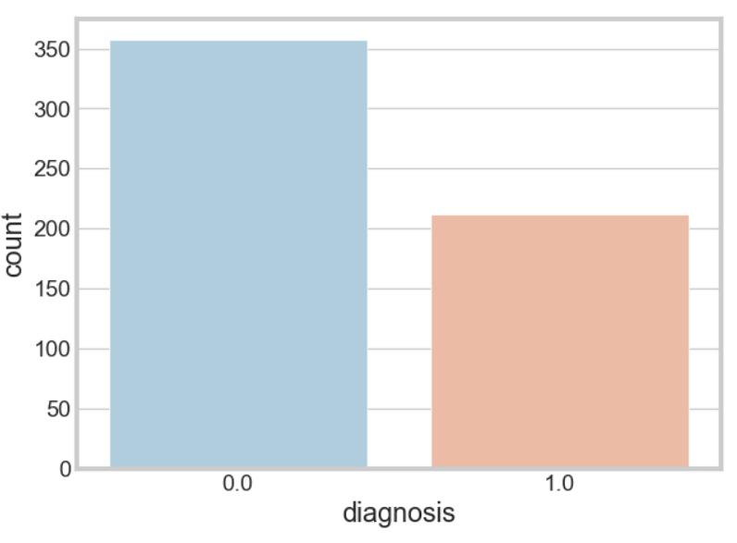
Countplot

Slide 11
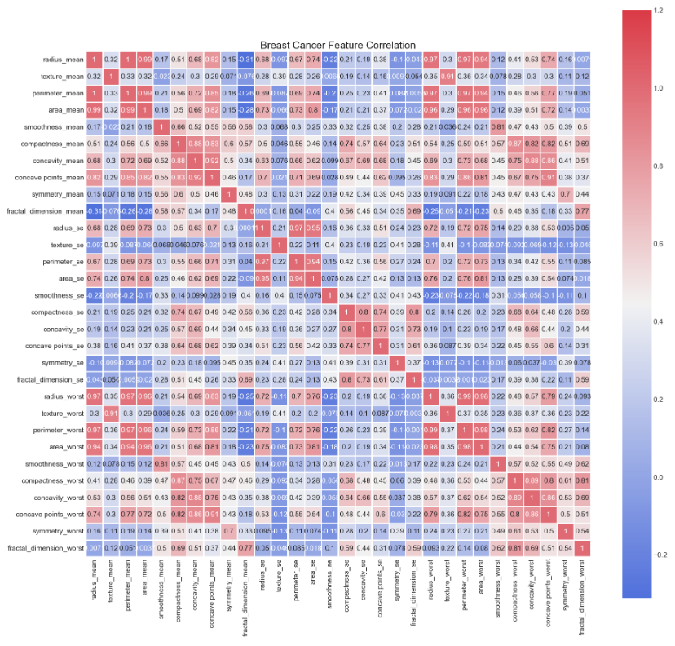

Slide 12
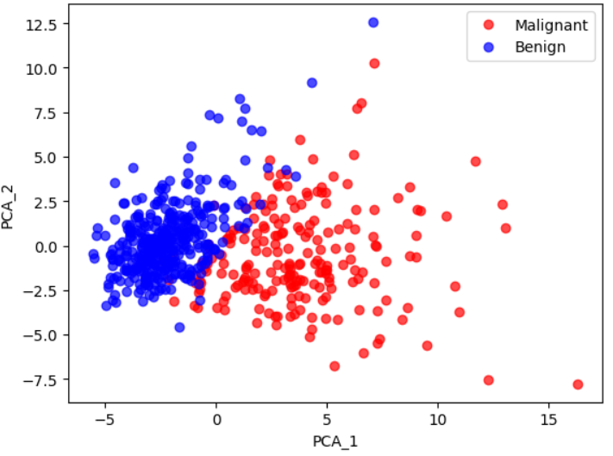
Methodology
3. Data Preprocessing
Find the most predictive features of the data and filter it so it will enhance the predictive power of the analytics model. Explore the variables to assess how they relate to the response variable with the data using data exploration and visualization techniques using python libraries (Pandas, matplotlib, seaborn).

Slide 13
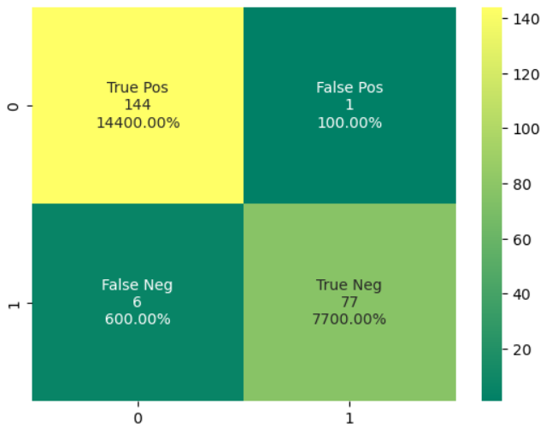
Methodology
4. Predictive Model using SVM
Construct predictive models to predict the diagnosis of a breast cancer. Construct a predictive model using SVM machine learning algorithm to predict the diagnosis of a breast cancer. We also evaluate the model using confusion matrix the receiver operating curves (ROC), which are essential in assessing and interpreting the fitted model.

Slide 14
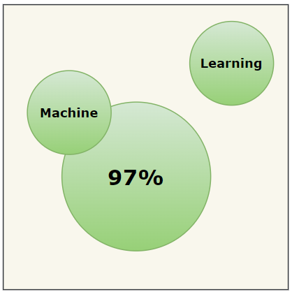

Accuracy

Slide 15

Result
All three of our algorithms have produced the same outcome after adding new data points. Thus, new data points may be properly predicted by our suggested techniques.
1= Malignant (Cancerous) - Present
0= Benign (Not Cancerous) -Absent

Slide 16
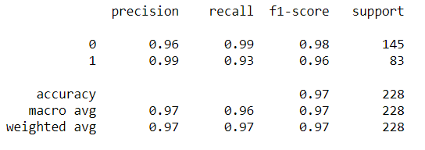
Result
Using SVM

Slide 17
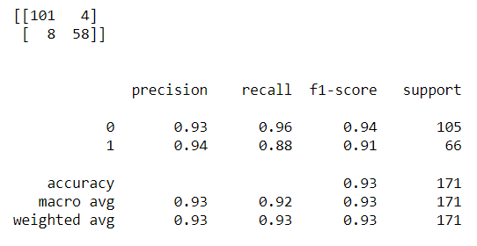
Result
Using KNN (K=10)

Slide 18
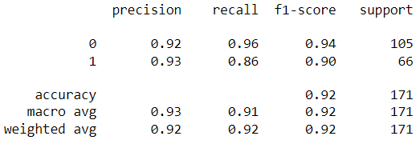
Result
Using Logistic Regression

Slide 19
Comparison of used algorithms
In previous slides, we can clearly see the difference in accuracy, precision, recall, f1-score among three algorithms. Among the three algorithms, SVM has the highest accuracy which is 97% while predicting breast cancer in women. On the other hand logistic regression model has 92% accuracy and the K-Nearest Neighbors (KNN) model has 93%. This is the main reason for using SVM most widely.

Slide 20
Conclusion
Breast cancer is a serious disease, if we early detect the cancer and start the treatment then it can significantly improve the survival rate. Machine learning models help to identify women’s breast cancer and play a significant role. Here we use SVM, KNN, and Logistic Regression models. The model was trained on a dataset containing 569 specimens of cancer cells, both harmless and malignant. The model developed in this project has an accuracy of over 98%, and it also has a high specificity and sensitivity.

Slide 21
Future Work
Our future objective will be:
Develop a more accurate risk prediction model.
Develop a real-time risk prediction model.
Develop models that can predict cancer treatment.

Slide 22
Thank You

